Slide 1
Time-Cost Trade-off in Project Management
Network Optimization Applications 19.11 by 成大工資管

Slide 2
Reference
Fulkerson, D. R. 1961. A network flow computation for project cost curve. Management Science 7, 167-178
Kelly, J. R. 1961. Critical path planning and scheduling: Mathematical basis. Operation Research 9, 296-320
Network Optimization Applications 19.11 by 成大工資管
Notes:
ELSP問題從1915年開始被廣泛討論
是幾個產品在單一機器做週期性生產的問題
每批為每個商品
每批應如何生產(安排時間)
假設生產速率固定

Slide 3
Introduction
Problem type : Time-Cost Trade-off
問題描述:
  在專案管理中工期若不符合決策者或雇主的需求，必須縮短工期。
  通常作業時間，可藉增加人力、機器設備等資源而予以縮短工期，當然增加各項個別作業直接費用…等成本，也會影響整個專案計畫的間接成本。
  Time-Cost Trade-off為著眼縮短整個專案計畫完成的時間，故問題變成如何在最低成本下，達成期望縮短整個專案計畫的時間，即以增加成本換取時間。
Network Optimization Applications 19.11 by 成大工資管
Notes:
ELSP問題從1915年開始被廣泛討論
是幾個產品在單一機器做週期性生產的問題
每批為每個商品
每批應如何生產(安排時間)
假設生產速率固定

Slide 4
Introduction
Project Scheduling Problems
1 precedes 3,4
2 precedes 4
3,4 precede 5
Dummy job
Completion Time : 0
Cost : 0
1
3
1
3
5
5
2
4
2
4
Node : job i
Duration : λ
Arc : job i
Node : events in time
“beginning” , “terminal”
Network Optimization Applications 19.11 by 成大工資管

Slide 5
Introduction
Given
  Cost ($/shorten the job duration)
  Project Completion Time (λ)
  Normal Completion Time (a_{i})
  Crash Completion Time (b_{i})
Decision
  u(i)：Start Time of job i
  u(j)：Start Time of job j (next job i)
  Reduction in Time required to complete job i
Object
  Minimize Cost to reduce project duration(λ) by reducing job durations
Network Optimization Applications 19.11 by 成大工資管

Slide 6


Introduction
Time-Cost trade-off curve of job i
di
Cost
bi
ai
Time
ai : Normal Completion Time
bi : Crash Completion Time
di : Unit crash Cost ($/單位趕工成本)
Network Optimization Applications 19.11 by 成大工資管

Slide 7
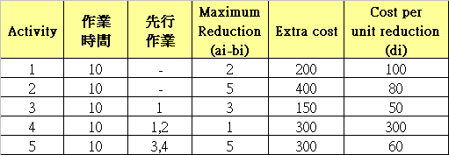
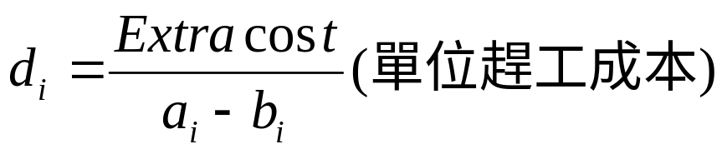
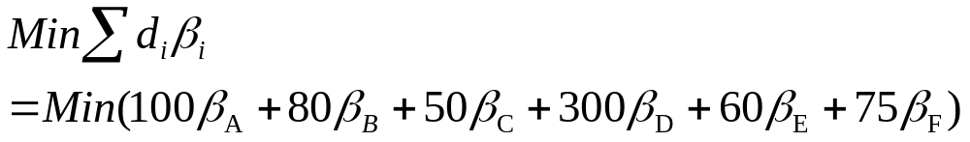
Objective
ES=10
1
3
ES=0
ES=20
ES=30
5
2
4
ES=10
Minimum 總趕工成本，找出最小β_{i}

Slide 8

Constraints(1/3)
ES=10
1
3
1
3
ES=0
ES=20
ES=30
u(s)=0
u(t)=λ
5
5
2
4
Project 期望於λ時間內完成
2
4
ES=10
(1)
s
．．．
t
Start
End
Network Optimization Applications 19.11 by 成大工資管

Slide 9

Constraints(2/3)
(2)
趕工後的job i作業工時
job i = arc(i,j)
u(i) = Day 0
u(j) >= Day 10
u(i) = Day 0
u(j) >= Day 8
趕工2days
8 Days
10 Days
8 Days
8 Days
u(i₂) = Day 0
u(i₂) = Day 0
若job i可趕工3天
Network Optimization Applications 19.11 by 成大工資管

Slide 10
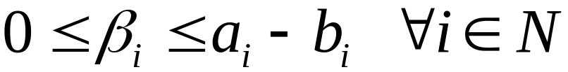
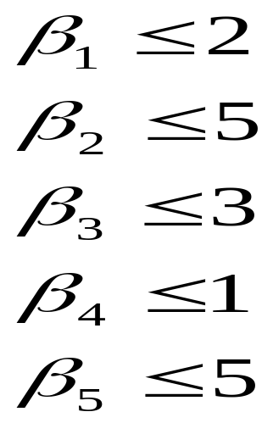
Constraints(3/3)
(3)
Network Optimization Applications 19.11 by 成大工資管

Slide 11
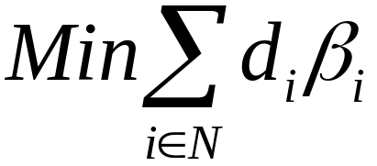


Formulation
(0)
(1)
(2)
(3)
Network Optimization Applications 19.11 by 成大工資管

Slide 12

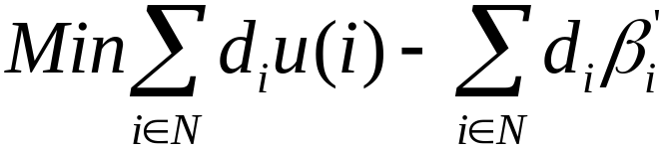
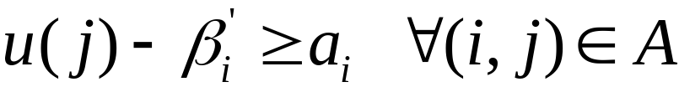
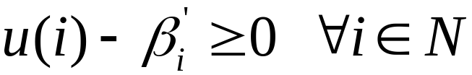
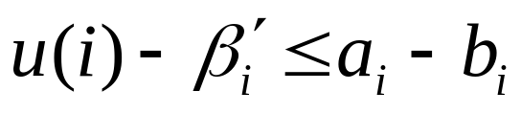

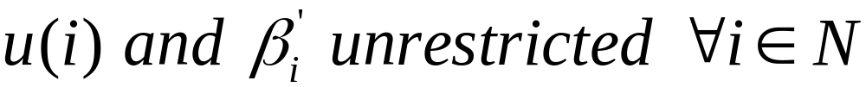
Solving Method
Dual of a Min Cost Flow Problem
Each row/column has at most +1 and -1
Theorem 9.9(p.315)
Obtain an optimal solution
using Min Cost Flow Algorithm
Network Optimization Applications 19.11 by 成大工資管

Slide 13
Thanks for Listening
Network Optimization Applications 19.11 by 成大工資管

Slide 14
Introduction
Total cost curve of project
總成本
累積趕工成本
期望間接成本
最佳
Network Optimization Applications 19.11 by 成大工資管

